Slide 1
Red-Black Tree

Slide 2
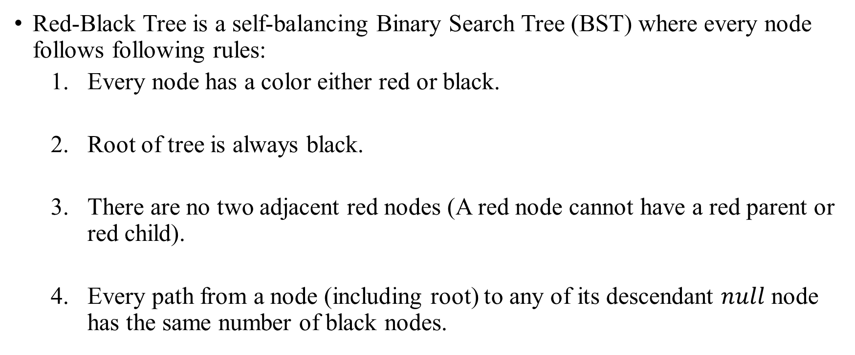
Red-Black Tree
Red-Black Tree is a self-balancing Binary Search Tree (BST) where every node follows following rules:
Every node has a color either red or black.
Root of tree is always black.
There are no two adjacent red nodes (A red node cannot have a red parent or red child).
Every path from a node (including root) to any of its descendant $null$ node has the same number of black nodes.

Slide 3
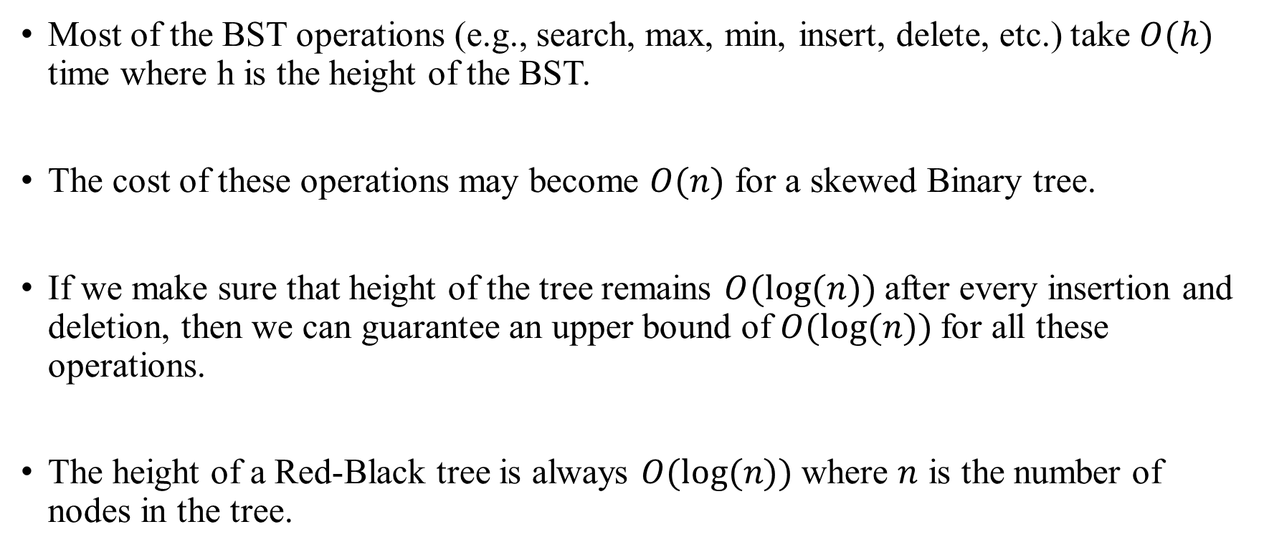
Red-Black Tree
Most of the BST operations (e.g., search, max, min, insert, delete, etc.) take $O(h)$ time where h is the height of the BST.
The cost of these operations may become $O(n)$ for a skewed Binary tree.
If we make sure that height of the tree remains $O(log⁡(n))$after every insertion and deletion, then we can guarantee an upper bound of $O(log⁡(n))$for all these operations.
The height of a Red-Black tree is always $O(log⁡(n))$where $n$ is the number of nodes in the tree.

Slide 4
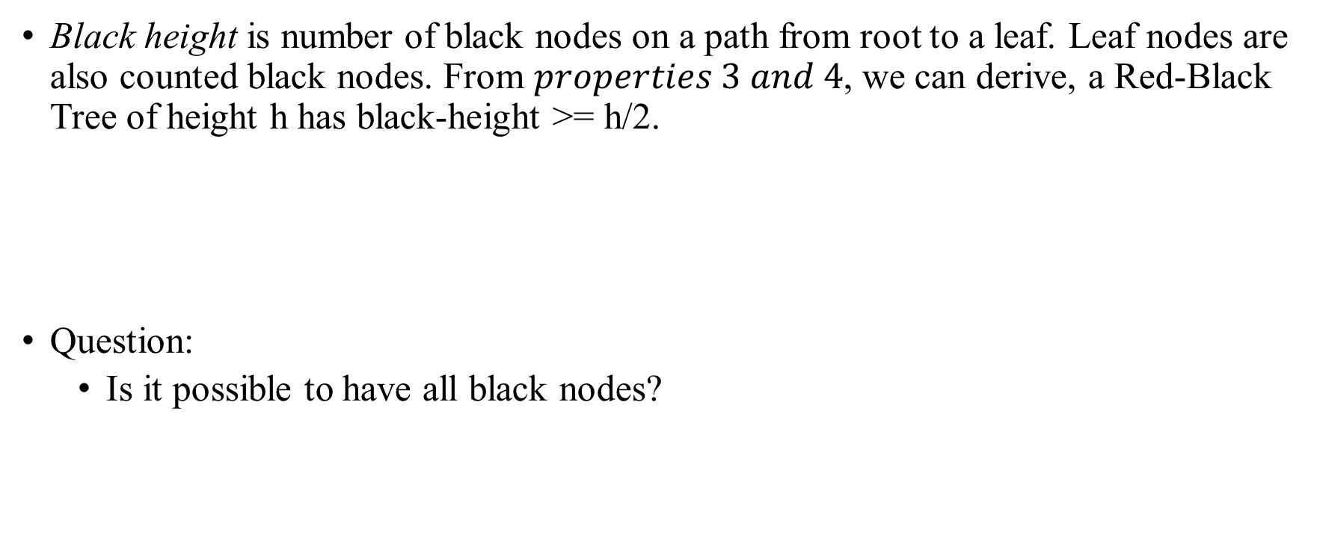
Red-Black Tree
Black height is number of black nodes on a path from root to a leaf. Leaf nodes are also counted black nodes. From $properties 3 and 4$, we can derive, a Red-Black Tree of height h has black-height >= h/2.
Question:
Is it possible to have all black nodes?
Every node is red or black.
Root is always black.
No adjacent red nodes.
Same number of black nodes.

Slide 5
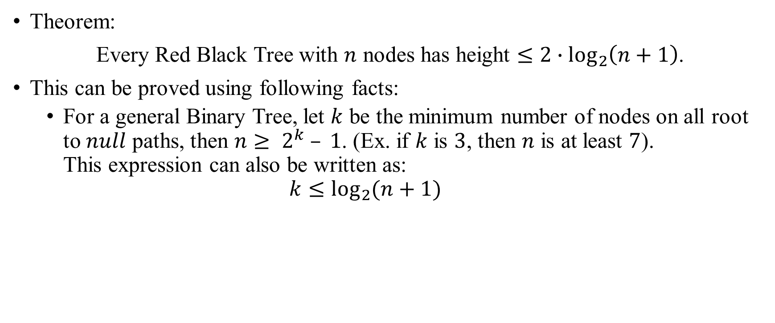
Red-Black Tree
Theorem:
Every Red Black Tree with $n$ nodes has height $≤2∙\log_{2}\left(n+1\right)$.
This can be proved using following facts:
For a general Binary Tree, let $k$ be the minimum number of nodes on all root to $null$ paths, then $n≥ 2^{k} – 1$. (Ex. if $k$ is $3$, then $n$ is at least $7$). This expression can also be written as: $k≤\log_{2}{(n+1)}$

Slide 6
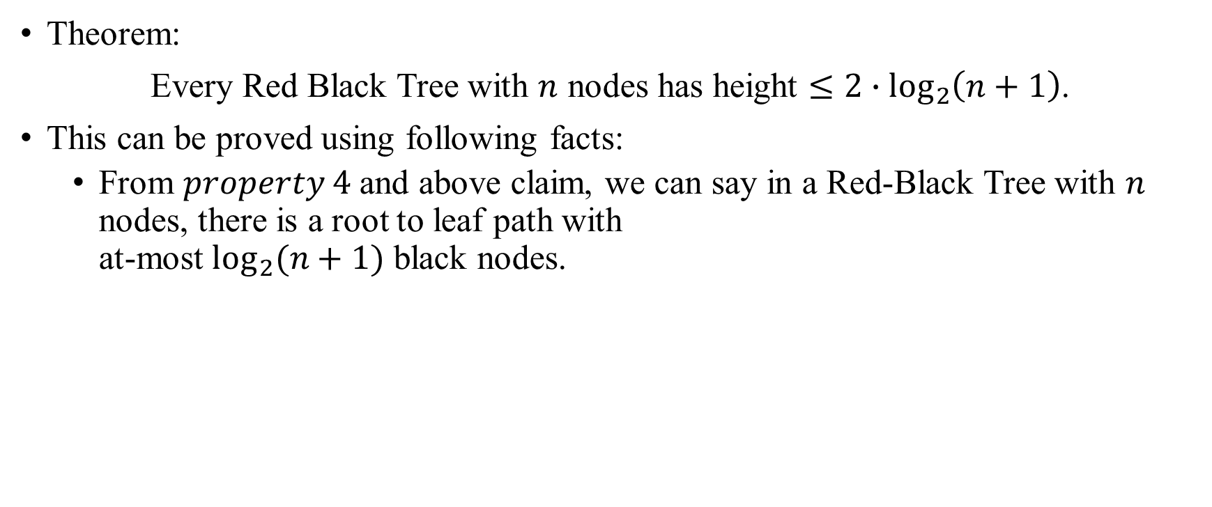
Red-Black Tree
Theorem:
Every Red Black Tree with $n$ nodes has height $≤2∙\log_{2}\left(n+1\right)$.
This can be proved using following facts:
From $property 4$ and above claim, we can say in a Red-Black Tree with $n$ nodes, there is a root to leaf path with at-most $\log_{2}(n+1)$ black nodes.
Every node is red or black.
Root is always black.
No adjacent red nodes.
Same number of black nodes.

Slide 7
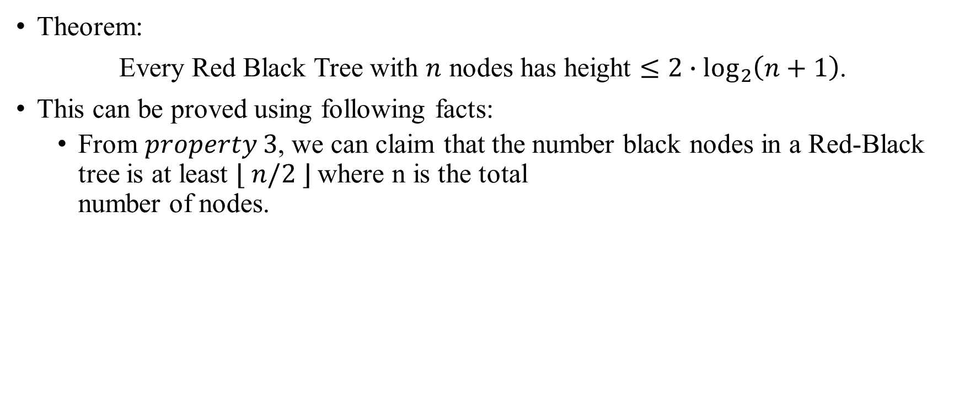
Red-Black Tree
Theorem:
Every Red Black Tree with $n$ nodes has height $≤2∙\log_{2}\left(n+1\right)$.
This can be proved using following facts:
From $property 3$, we can claim that the number black nodes in a Red-Black tree is at least $⌊ n/2 ⌋$where n is the total number of nodes.
Every node is red or black.
Root is always black.
No adjacent red nodes.
Same number of black nodes.

Slide 8
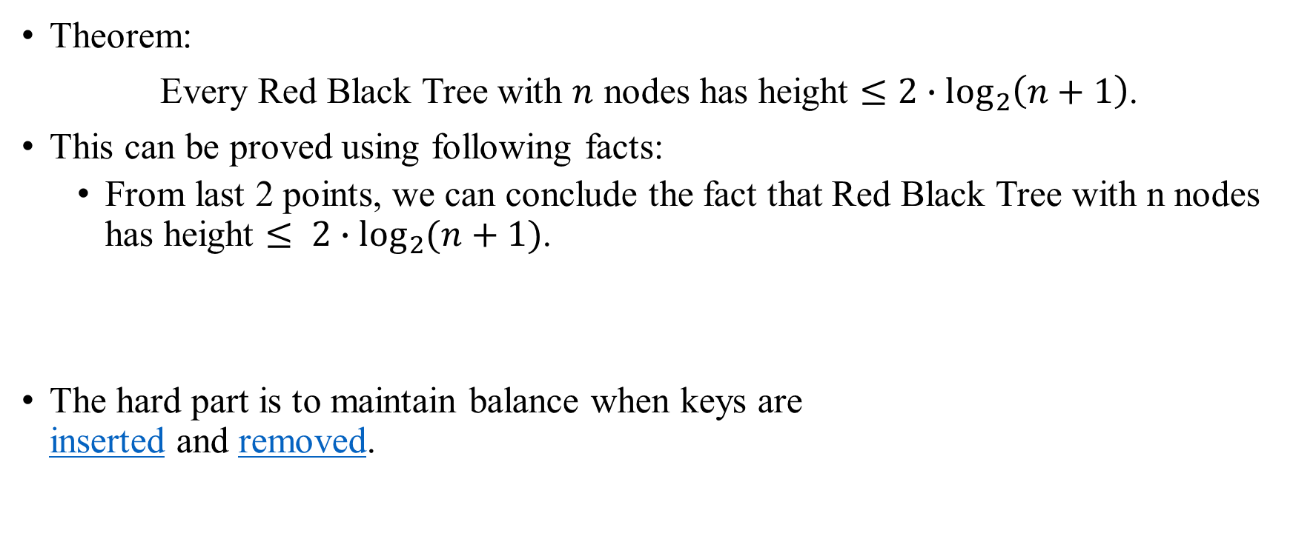
Red-Black Tree
Theorem:
Every Red Black Tree with $n$ nodes has height $≤2∙\log_{2}\left(n+1\right)$.
This can be proved using following facts:
From last 2 points, we can conclude the fact that Red Black Tree with n nodes has height $≤ 2∙\log_{2}{(n+1)}$.
The hard part is to maintain balance when keys are inserted and removed.
Every node is red or black.
Root is always black.
No adjacent red nodes.
Same number of black nodes.

